Slide 1
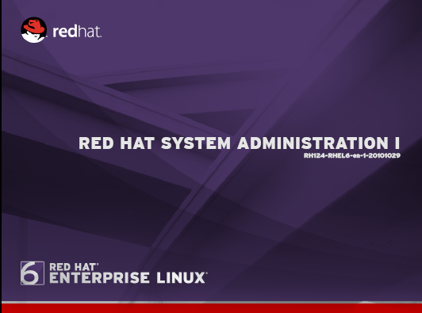
KR Network Cloud Tech. Pvt. Ltd.
:::::::: some simple commands :::::::::::::
Date ----to display date and time.
Cal ------ to display calendar of the current month.
# date
# date --help
# date +”Today is %A, %B %d, %Y.%nIt is %r, %Z. “
#cal
#cal 2011
#cal 5 2011
#cal 2 2012
# cal - 3 6 2011
{ use the -3 option to the cal command to get a calendar for the month of june , 2011 ,plus the months before and after }
# date ‘+%x’
[ to prints date in MM/DD/YY format]

Slide 2
KR Network Cloud Tech. Pvt. Ltd.
::::::::::::::: Getting Help ::::::::::::::::::::
Do not try to memorize everything .!
Many levels of help :::
whatis
commnad --help
man and info
/usr/share/doc/----
Red Hat Documentation.
::::::: Whatis Command :::::::
Displays short descriptions of commands.
Prints the commands name and a number in parenthesis.
( Note )::::The database that whatis uses is regenerated automatically every night. This means that on Newly installed systems whatis will not work at first because the database does not yet exist. If you want than run this command by login with root users #makewhatis

Slide 3
KR Network Cloud Tech. Pvt. Ltd.
Examples :::
# whatis cp
# whatis rm
# whatis ifconfig
# whatis cal

Slide 4
KR Network Cloud Tech. Pvt. Ltd.
:::::::::::::::::: --help Option :::::::::::
Displays usage summary and arguments list
Used by most , but not all , commands.
Examples :::
#date -- help
#cp -- helpss
#rm -- help
::::::::::: man command :::::::::::
Provides documentation of any commands.
Almost every command has a man pages.
Pages are grouped into “chapters”.

Slide 5
KR Network Cloud Tech. Pvt. Ltd.
Syntax ::: # man <chapter> <command>
The linux manual is devided into sections , each of which covers a particular topics.
Sections are ::
For user commands.
System calls.
Library calls.
Specials files.
File formats.
Games.
Miscellaneous.
Administrative commands.

Slide 6
KR Network Cloud Tech. Pvt. Ltd.
Examples :::
#man passwd
#man 1 passwd
#man 5 passwd
#man cp
#man ifconfig
# man 7 man

Slide 7
KR Network Cloud Tech. Pvt. Ltd.
Navigating of man pages,,,,,,,,
While viewing a man pages.
Then press PageUp and PageDown tWhile viewing a man pages.
Then press
and
o navigate with arrows.
/text search for text.
Press n goes to next match and N to previous match.
q to quit.

Slide 8
KR Network Cloud Tech. Pvt. Ltd.
:::::::::::::::::::::: info command :::::::::::::::
Similar to man command , but often more in-depth.
Run info command without args to list all pages
Info pages are structured like a web site .
Each page is divided into “nodes”.
Links to nodes are preceded by * .
Syntax :::: # info <commnad>
# info cp
# info rm

Slide 9
KR Network Cloud Tech. Pvt. Ltd.
Navigating info pages..
While viewing in info page.
Navigate with arrows , PageUp and PageDown.
Tab moves to next link.
n/p/u/l goes to the next/previous/up-one/last node
s text searches for text
q to quit

Slide 10
KR Network Cloud Tech. Pvt. Ltd.
::::::::::::::::::::::: Extended Documentation :::::::::
the /usr/share/doc directory.
Subdirectories for most installed packages.
Location of docs that do not fit elsewhere
1 . Example configuration files.
2 . HTML/PDF/PS documentations.
3. License details.
Basically it contains sample configuration files, tutorials and even entire books extending the documentation of the application.
#cd /usr/share/doc/dhcp # ls # vim readmes

Slide 11
KR Network Cloud Tech. Pvt. Ltd.
Documentation :::::::::::::::::::::::::::: Red Hat
Available at http://www.redhat.com/docs/
Installation guide.
Deployment guide
Virtualization guide
Knowledge base at http://kbase.redhat.com/
Common questions and their solutions.
Deployment Guide :::
System--Documentation -Deployment guide
or
# yelp ghelp:Deployment_Guide

Slide 12
KR Network Cloud Tech. Pvt. Ltd.
Linux File Hierarchy concepts :::::
Filesystem begain at the root directory , represented by / or root
( forward slash ).
Names are case-senstive.
/boot
/home

Slide 13
KR Network Cloud Tech. Pvt. Ltd.
Nautilus ::::
Nautilus is a graphical filesystem browser provided as part of the Gnome graphical environment.
While managing files from the command line can be more versatile and powerful , many people consider a graphical interface more intuitive.

Slide 14
KR Network Cloud Tech. Pvt. Ltd.
:: file management from the command line ::
The location of a directory or file can be specify by either of two methods
Absolute path :::
Bgin with a forward slash.
Coemplete “road map ” to the file location.
Can be used anytime you wish to specify a file name.
Relative path :::
Do not begin with a slash.
Specify location relative to your current working directory.
Can be used as a shorter way to specify a file name.

Slide 15
KR Network Cloud Tech. Pvt. Ltd.
::::::: Changing directories :::::::
cd ( changes directories )
cd . .
{ to a directory one level up}
cd
{ to your home directory }
cd -
{ to your previous working directory }

